Slide 1
Java String
Strings, which are widely used in Java programming, are a sequence of characters.
In Java programming language, strings are objects.
In java, string is basically an object that represents sequence of char values.
The Java platform provides the String class to create and manipulate strings.
String is probably the most commonly used class in java library. String class is encapsulated under java.lang package.
String greeting = "Hello world!";

Slide 2
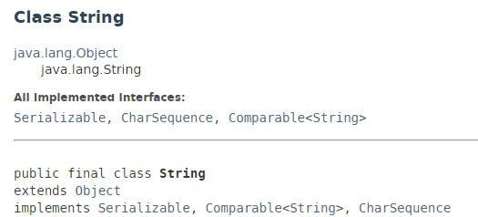
Java String
The String class is immutable, so that once it is created a String object cannot be changed.
The String class has a number of methods, some of which will be discussed below,
that appear to modify strings. Since strings are immutable, what these methods really do is create and return a new string that contains the result of the operation.

Slide 3
Java String
https://docs.oracle.com/javase/8/docs/api/index.html?java/lang/String.html

